Slide 1
Creating an Automated Coaching Assistant: Implementing Technology to Assess Quality of Strength Training
Michael Clougher ‘15
Advisor: Professor Izmirli

Slide 2
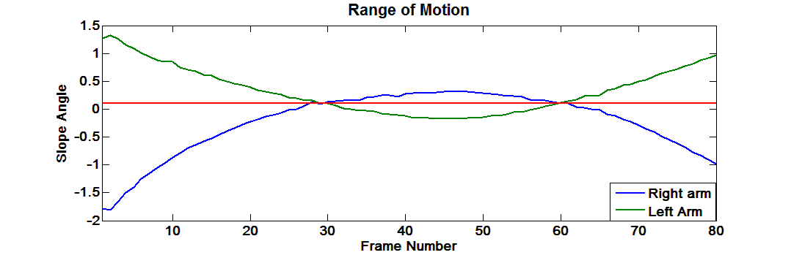
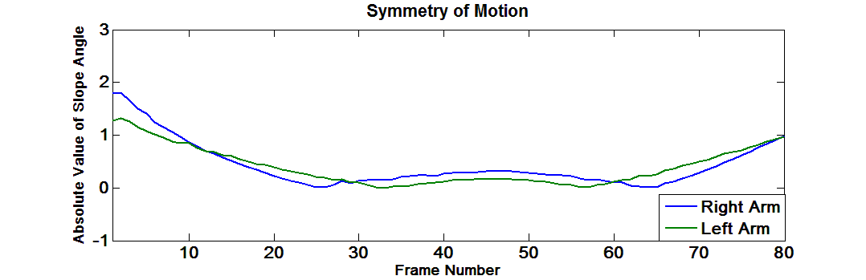
Earlier Work
Earlier Work
Replace need for personal trainers
Simple exercises
Feedback up to interpretation
One camera utilized

Slide 3
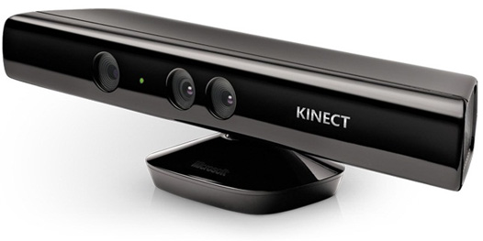
This Semester
Concentrate on complex exercise
One camera insufficient
Noise estimates from occlusion
Need to improve accuracy
One view informs the other

Slide 4

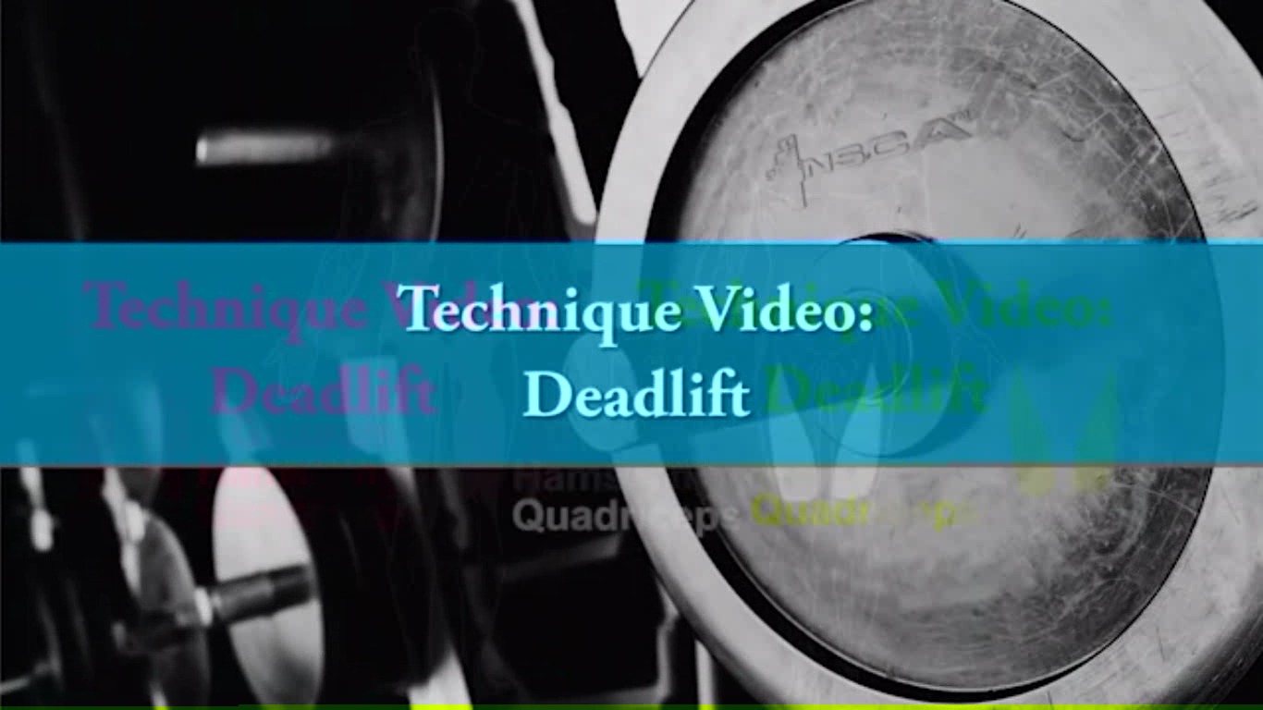
Performing the Exercise
Analyzing the deadlift exercise
Common exercise, yet easy to get hurt

Slide 5
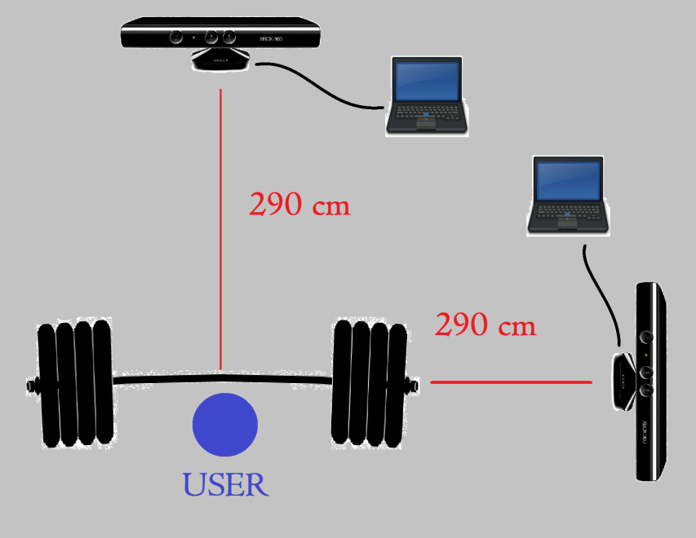
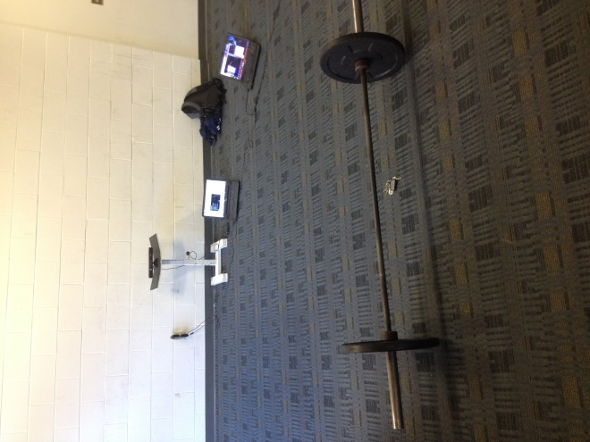
Common Errors
Feet not shoulder width apart
Bar not traveling along same path
Pulling with the arms
Rounding of the back
Raising trunk before hips/knees

Slide 6
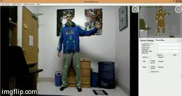
How this Agent Works
Record skeleton and depth data
Synchronize images from two laptops
Analyzed using MATLAB

Slide 7
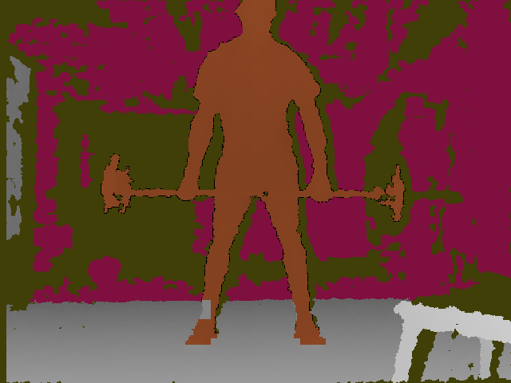
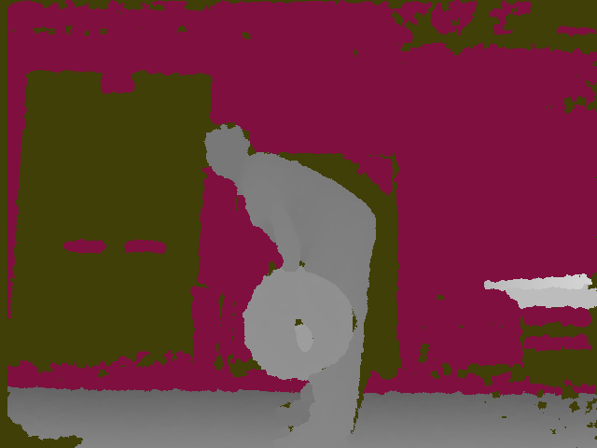

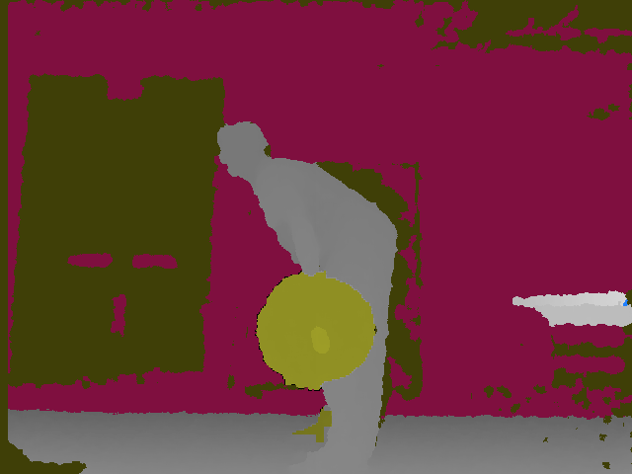
Challenges
Synchronizing front and side views
Conversion between pixels and centimeters
Inconsistency of depth images
Skeleton somewhat unreliable

Slide 8
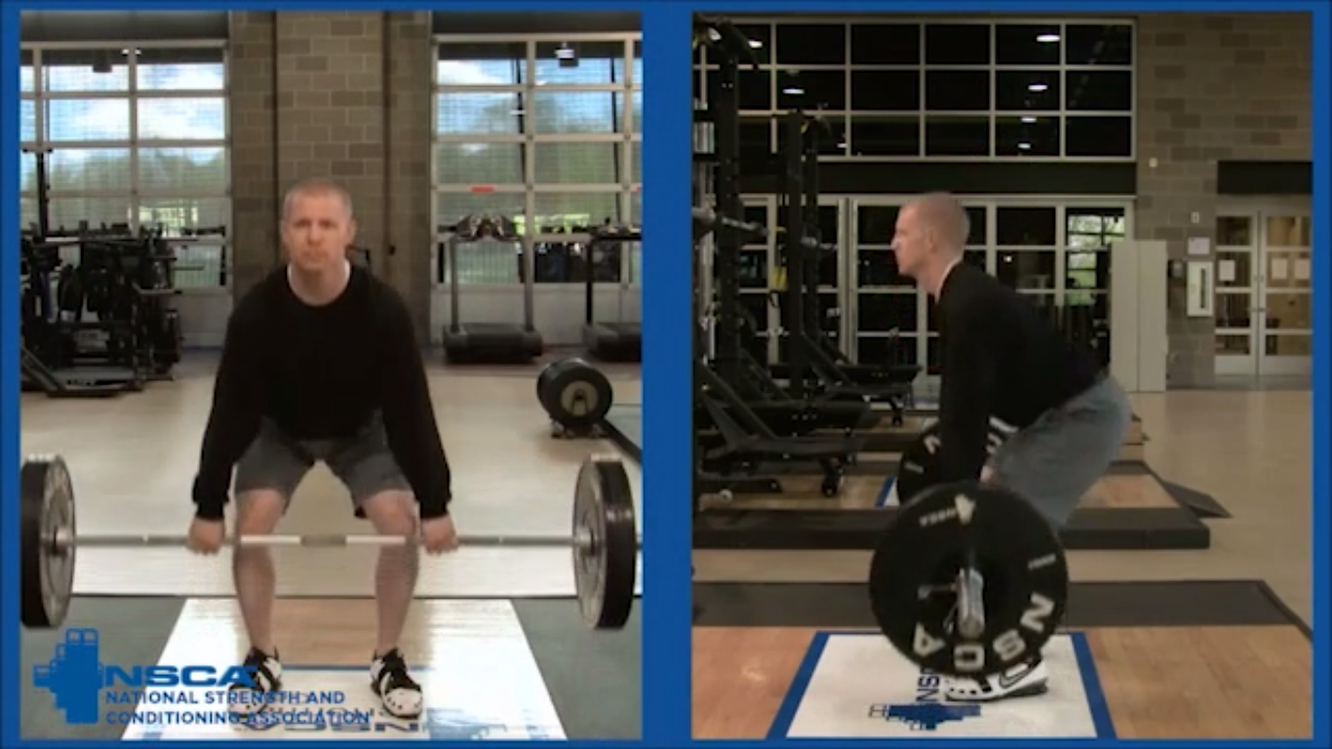
Conclusion
Replace need for personal assistant
Strength training at home
Remove subjectivity
Affordable technology

Slide 9
References
[1] J. Smisek, M. Jancosek, and T. Pajdla, “3d with Kinect,” in ICCV
Workshops, pp. 1154–1160, 2011.
[2] E. E. Stone and M. Skubic, “Evaluation of an Inexpensive Depth
Camera for passive in-home fall risk assessment,” in PervasiveHealth,
pp. 71–77, 2011.
[3] S. Obdrzalek, G. Kurillo, F. Oﬂi, R. Bajcsy, E. Seto, H. Jimison and M. Pavel “Accuracy and Robustness of Kinect Pose Estimation in the Context of Coaching of Elderly Population”
[4] J.-D. Huang, “Kinerehab: A kinect-based system for physical rehabilitation a pilot study for young adults with motor disabilities,” in In Proceedings of ASSETS11, (Dundee, Scotland, UK.), pp. 319–320, October 2426 2011.
[5] B. Lange, C.-y. Chang, E. Suma, B. Newman, A. S. Rizzo, and M. Bolas, “Development and evaluation of low cost game-based balance rehabilitation tool using the microsoft kinect sensor,” Conference
Proceedings of the International Conference of IEEE Engineering in Medicine and Biology Society, vol. 2011, pp. 1831–1834.
[6] M. J. D. Taylor, D. McCormick, T. Shawis, R. Impson, M. Griffin “Activity-promoting gaming systems in exercise and rehabilitation”

Slide 10


Questions???

